Slide 1
Office 365 Development

Slide 2
Course Agenda
Deep Dive into the Building Blocks and Services of the SharePoint Platform
Module 1: Developing Advanced Workflow Scenarios in Office 365
Module 2: Deep Dive into SharePoint Lists for Data Storage
Module 3: Deep Dive into SharePoint Lists with REST APIs
Module 4: Deep Dive into SharePoint Lists with CSOM APIs
Module 5: SharePoint 2013 Remote Event Receivers
Module 6: Deep Dive into Search Scenarios in Office 365
Module 7: Deep Dive into Business Connectivity Services in Office 365
Module 8: Developing Advanced Taxonomy Scenarios in Office 365

Slide 3
O3656-4 Deep dive into SharePoint Lists with CSOM APIs
Ted Pattison
Andrew Connell

Slide 4

Agenda
Motivation
CSOM Overview
Optimizing the Execution of CSOM Queries
Creating Lists and Document Libraries
Registering Remote Event Receivers

Slide 5
Motivation

Slide 6
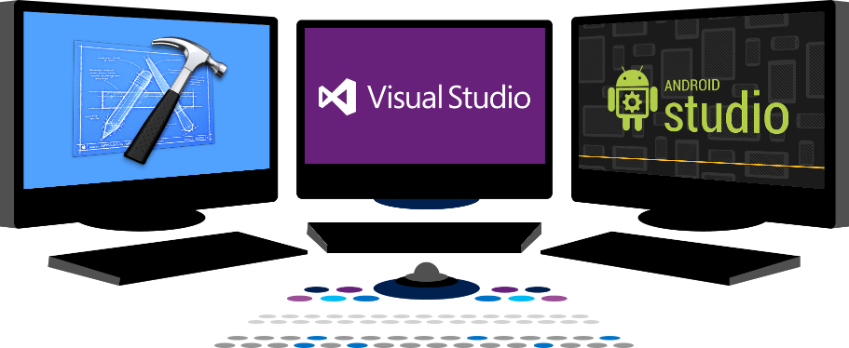














Vision
EXTEND OFFICE EVERYWHERE
CONNECT TO OFFICE 365 SERVICES
BUILD USING AN OPEN PLATFORM
Delve
z
Users and groups
Files
Mail
Calendar
My Apps
Video Portal
Contacts
Office Graph
Presentations
Documents
Spreadsheets
Lync
OneNote
Yammer

Slide 7
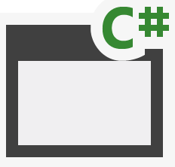
SharePoint App Building Blocks
SharePoint Apps
aspx
Databases
png
master
CSS
js
Web Services
SharePoint
REST
CSOM
SharePoint API
Managed
Metadata
Search
Service
Workflow
Service
BCS
List and Libraries
Service Applications

Slide 8
Why Client Object Model (CSOM)?
Advantages of CSOM over the REST API
Strongly-typed programming
Higher productivity when writing C# or VB.NET
Provides ability to batch requests to web server
Some areas are covered by CSOM but not REST
Notes:
x

Slide 9
CSOM Overview

Slide 10
Supported Areas
What can you do with CSOM?
Work within a specific site collection
Read and modify site properties
Create site columns and content types
Create lists, items, views and list types
Register remote event handlers
Create folder and upload and download files
Add web part and web part pages
Notes:
The Client Object Model contains a lot of overlap coverage with the full SharePoint API. A lot activities that are possible through the SharePoint API, are also possible through the different client object models.

Slide 11
CSOM Expansion in SharePoint 2013?
New APIs with SharePoint Server functionality
User Profiles
Search
Taxonomy
Feeds
Publishing
Sharing
Workflow
E-Discovery
IRM
Analytics
Business Data
Notes:
This slide above lists new areas in the SharePoint 2013 remote API that are accessible through both CSOM and REST. This is a welcome change because most of this functionality is only available through server-side APIs in a SharePoint 2010 farm. You can also see adding this remote access is very important to the new app model where developers can no longer run code in a SharePoint environment not can they access the server-side APIs.

Slide 12
SharePoint 2013 Remote API Architecture
_api is new alias for _vti_bin/client.svc
Server
Execute Query
Client
OData
JavaScript Library
Silverlight Library
.Net CLR Library
Custom Client Code
Notes:
This architectural diagram shows how things have changed in SharePoint 2013. client-side code uses the CSOM in SharePoint 2010. The major changes include:
You can substitute the alias _api in order to reference _vti_bin/client.svc
Client code can access client.svc directly using REST-based HTTP requests.
Much of the REST-based API is based on the OData protocol.
Code which uses the CSOM in SharePoint 2010 should migrate to SharePoint 2013 without any problems.
It is important to note that the CSOM is not the same as the REST/OData interface. Microsoft has focused primarily on the CSOM while added REST/OData endpoints in many cases, but in many cases you will find there is no REST/OData where there is CSOM coverage.

Slide 13
Changes to CSOM in SharePoint 2013
SharePoint Foundation 2013
No significant changes to CSOM beyond REST support
Primary investment was adding REST to existing API
SharePoint Server 2013
New APIs added with CSOM and REST support
Notes:
The primary enhancement to the CSOM for SharePoint Foundation is that the majority of it functionality has now also been exposed to Web service clients making REST calls across the network. This makes it easier to program JavaScript behind Web pages and it opens to doors to client applications that do not run using the .NET framework.
While SharePoint foundation does not expand its CSOM functionality, many of the SharePoint server services that did not expose Web service entry points in SharePoint 2010 now do in SharePoint 203. Some examples are Web services exposed for document management, WCM, terms and term sets and user profiles. You should also note that most (but not all) new CSOM functionality introduced in SharePoint Server 2013 is also mirrored with REST-based entry points as well.

Slide 14
Programming using CSOM
Your JavaScript Code
Browser
JSON Response
Client.svc
Server OM
JavaScript OM
Proxy
XML Request
Proxy
XML Request
Content database
Managed OM
JSON Response
Managed Client
Your C# and VB.NET Code
SharePoint Web Server
Notes:
There are three different entry points you can use to program against the CSOM.
.NET Applications
Silverlight Applications
JavaScript code
.NET applications and Silverlight applications program against class in an assembly while JavaScript code programs against JavaScript objects made accessible through sp.js. In all three cases the programmer is shielded from having to send and receive WCF messages are they are sent to the Web server.

Slide 15
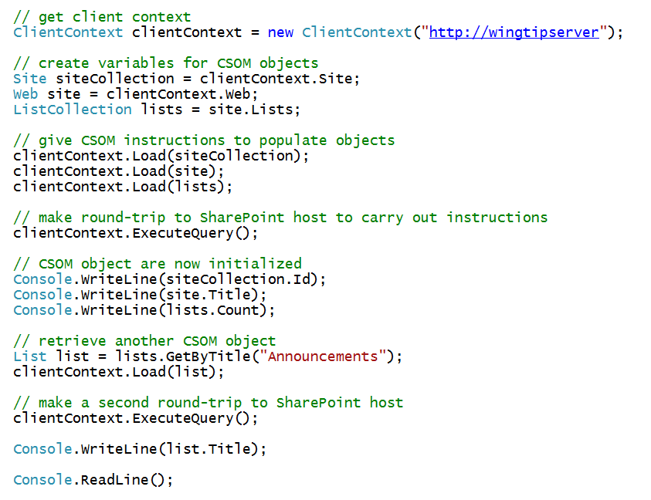
CSOM using Managed Code
Notes:
The slide shows an example of CSOM code which accomplishes the following:
Establishes a connection to the SharePoint farm using default credentials
Retrieves information about the current site
Creates a new Contacts list
Retrieves and display information about the lists in the current site

Slide 16
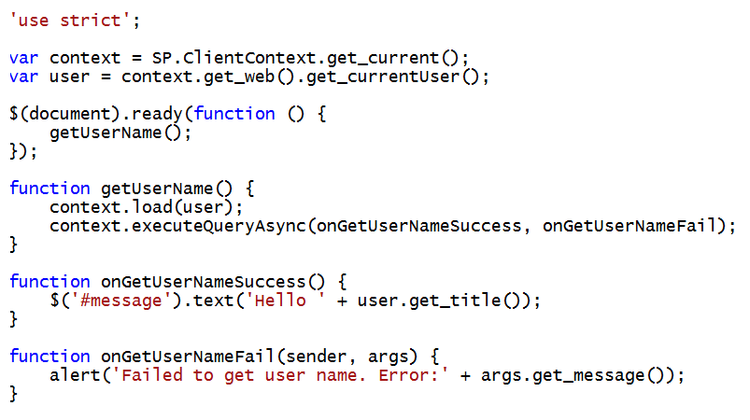
CSOM using JavaScript
Notes:
This slides shows a typical example using the CSOM from JavaScript behind a page in a SharePoint 2013 site. This code also leverages jQuery and in particular the document ready function to execute the onPageLoad function when the DOM is ready to access. Note how this code calls ExecuteOrDelayUntilScriptLoaded to force the download of sp.js before executing the initializeCSOM function. This is a common practice to ensure that that CSOM is available for use before you begin to program against it.

Slide 17
Authentication using CSOM
CSOM support user auth and app auth
User auth can use Windows of Forms Authentication
External auth used for apps with server-side code
Set authentication mode:
clientCtx.AuthenticationMode =
ClientAuthenticationMode.FormsAuthentication;
Specify user authentication details:
FormAuthenticationLoginInfo loginInfo = new FormAuthenticationLoginInfo(“User”,”password”);
clientCtx.FormsAuthenticationLoginInfo = loginInfo;
Notes:
By default, the managed client object models authenticate users by using their Windows credentials (DefaultCredentials). Optionally, you can change the authentication mode on the ClientContext object and specify using Forms authentication instead. A user must then supply a user name and password through properties on ClientContext. Behind the scenes, SharePoint Foundation calls the Authentication Web service, obtains the correct cookie, and then makes the necessary object model calls. To run managed client code against a Forms authentication server, you must change to Forms authentication. This requirement does not apply to the JavaScript object model.
The managed client object models provide a ClientAuthenticationMode enumeration whose values are Anonymous, Default, and FormsAuthentication. To specify Forms authentication, use code similar to the following:
clientContext.AuthenticationMode = ClientAuthenticationMode.FormsAuthentication;
In addition to setting the authentication mode, you must specify the user name and password information, such as follows:
FormsAuthenticationLoginInfoformsAuthInfo = new FormsAuthenticationLoginInfo("MyUser", "MyPassword");
clientContext.FormsAuthenticationLoginInfo = formsAuthInfo;
Note: The account name and password in formsAuthInfo are sent in clear text, so you must use HTTPS protocol instead of HTTP.

Slide 18
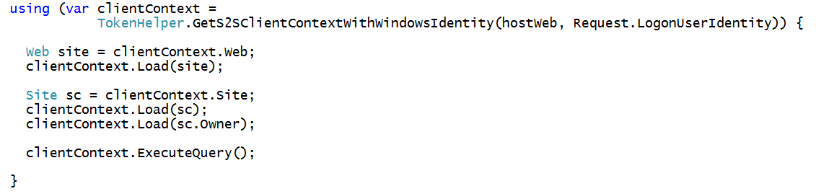
Authenticating from the Remote Web
Create client context with access token
Call GetS2SClientContextwithWindowsIdentity
Commonly done inside using statement
Pass null value for user name for App-only identity

Slide 19
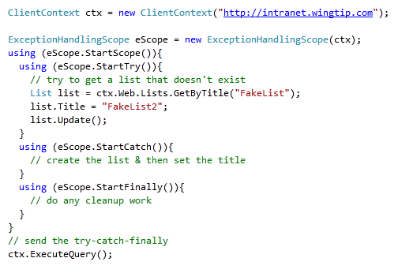
Remote Error Handling
CSOM supports structured exception handling
However, it’s an API not a language feature
Reduces chatty & time consuming round-trips to server
Notes:
After creating the ClientContext, you can create a ExceptionHandlingScope. You can wrap up all your code that communicates with the client object model within a using(eScope.StartScope()){...} to avoid that exceptions go back and forth over the wire. All exceptions are queued and can be checked in the using (StartCatch()){...} part of your code.

Slide 20
Optimizing the Execution of CSOM Queries

Slide 21
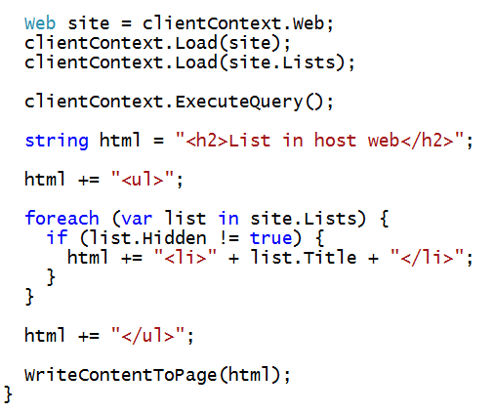
What’s Wrong with This Code?

Slide 22
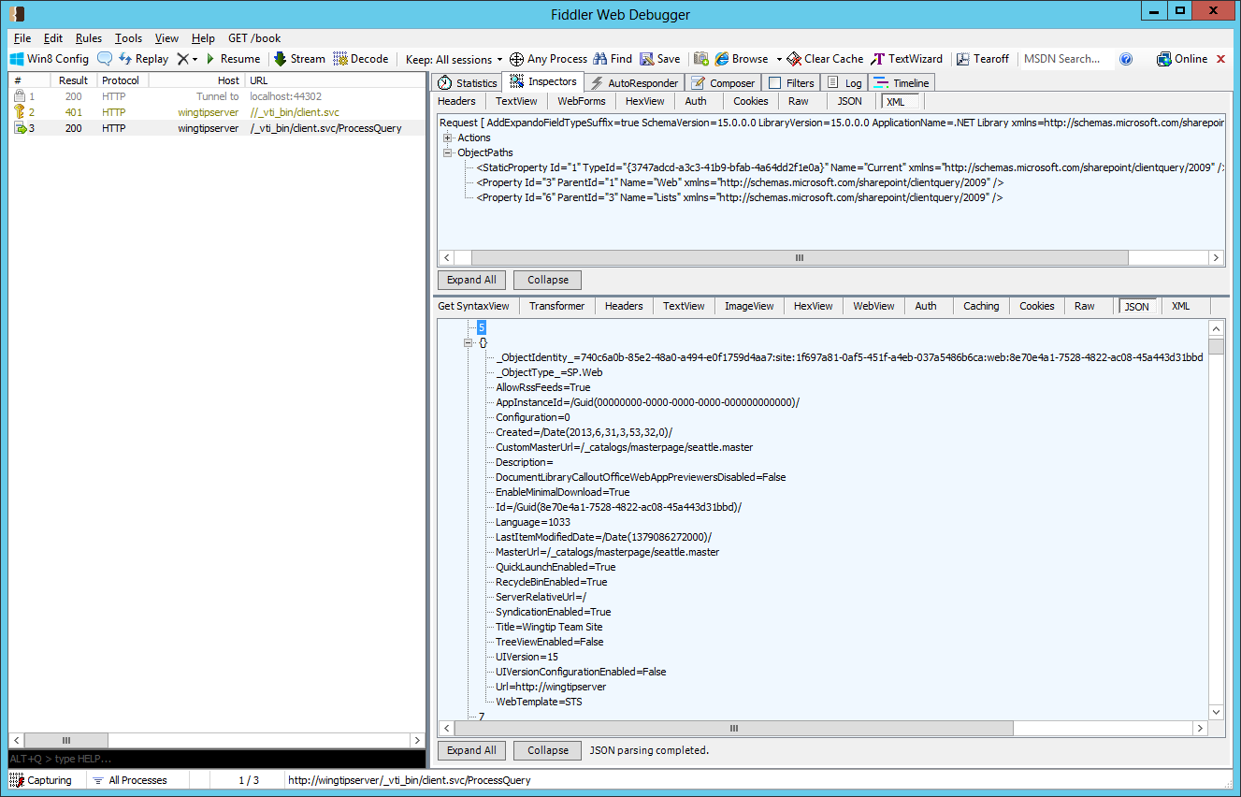

Inspecting CSOM Calls using Fiddler

Slide 23
Lambda Expressions
C# supports the use of lambda expressions
Syntax Introduced as part of LINQ with .NET 3.5
Can (and should) be used with CSOM programming
Lambda expression is an anonymous function
It defines a parameter list and a function body
[Parameter_list] => [Function_Body]
Input Parameter(s)
Lambda Operator
Statement Block
read as "value goes into value starts with B"

Slide 24
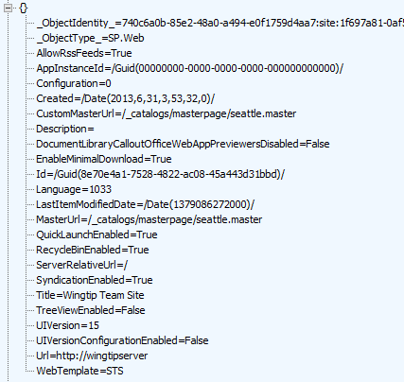


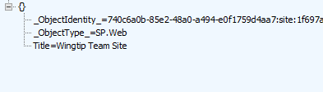
Using Lambda Expressions
Loading an object populates all scalar property values
Can result in inefficient use of network bandwidth
Lambda expressions can be used to optimize
You can indicate which properties you want populated

Slide 25
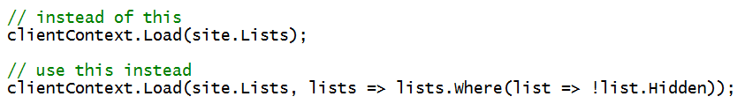
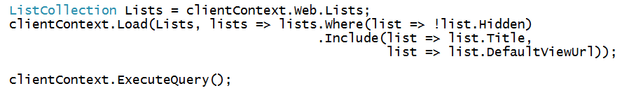
Using Where() and Include()
Where lets you pass filter criteria to server
Include lets you pick fields on item in a collection
Syntax is powerful although hard to read and write at first

Slide 26
demo
Optimizing CSOM Queries

Slide 27
Creating Lists and Document Libraries

Slide 28
Creating Objects
CSOM uses pattern based on creation objects:
ListCreationInformation()
ListItemCreationInformation()
WebCreationInformation()
NavigationNodeCreationInformation()
…
Notes:
You cannot only retrieve data using the ClientOM, but you can also create objects using specific classes.
ListCreationInformation: use this class to create a new list. You can set properties like Title and TemplateType before calling the web.Lists.Add method, passing the ListCreationInformation object as argument.
ListItemCreationInformation: use this class to create a new list item on an existing list. The AddItem method on the List object accepts the ListItemCreationInformation argument and returns the new list item of type ListItem. You can fill out the list item using the listItem["Title"] syntax for the different columns on the list, and calling the Update() method on the list item.
WebCreationInformation: if you want to create a new SharePoint site, instantiate an object of this type and pass it to the Webs.Add method of a Web object.
NavigationNodeCreationInformation: use this class to create a new navigation node.

Slide 29
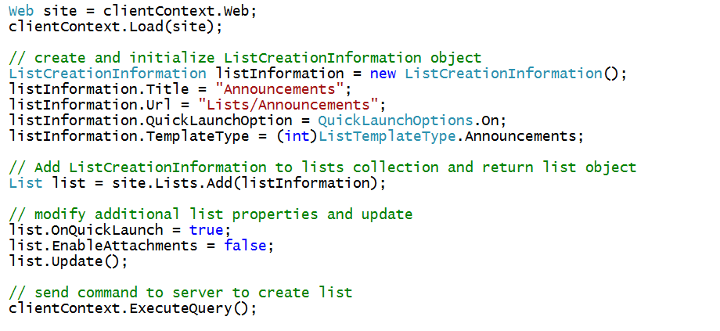
Creating a List

Slide 30
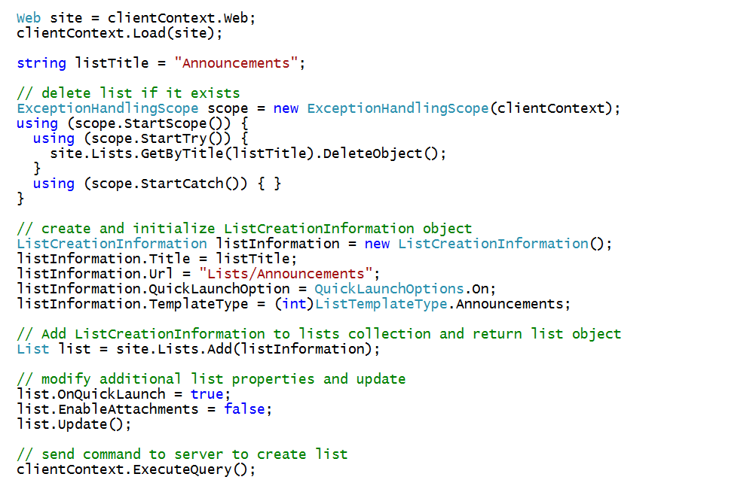
Checking Whether the List Already Exists

Slide 31
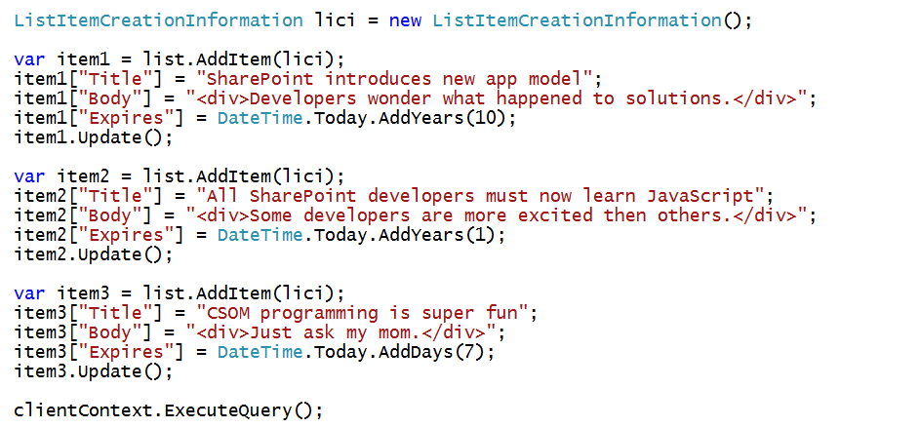
Creating List Items

Slide 32
demo
Creating Content Types and Lists using CSOM

Slide 33
Registering Remote Event Receivers

Slide 34
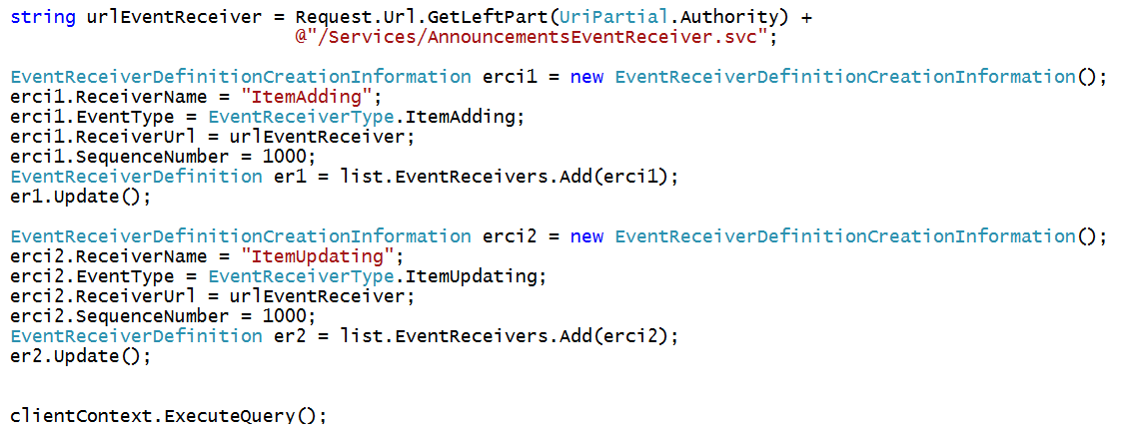
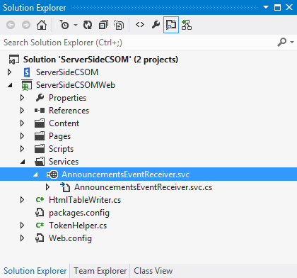
Registering Remote Event Receivers
Remote Event Receivers require registration
Declarative registration only possible in app web
Registration in host web requires CSOM code
Remote web must supply the required entry point (e.g. MyEventReceiver.svc)

Slide 35
Summary
CSOM Overview
Optimizing the Execution of CSOM Queries
Creating Lists and Document Libraries
Registering Remote Event Receivers

Slide 36
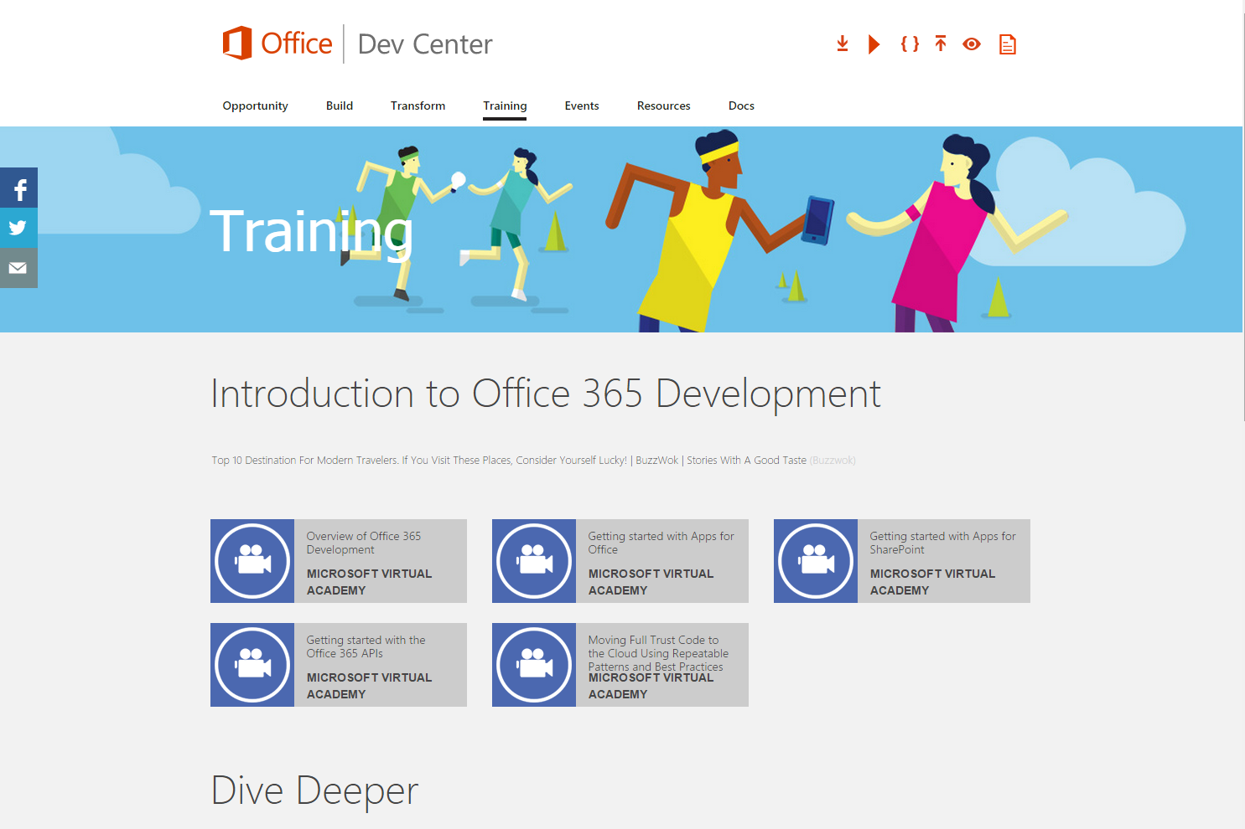
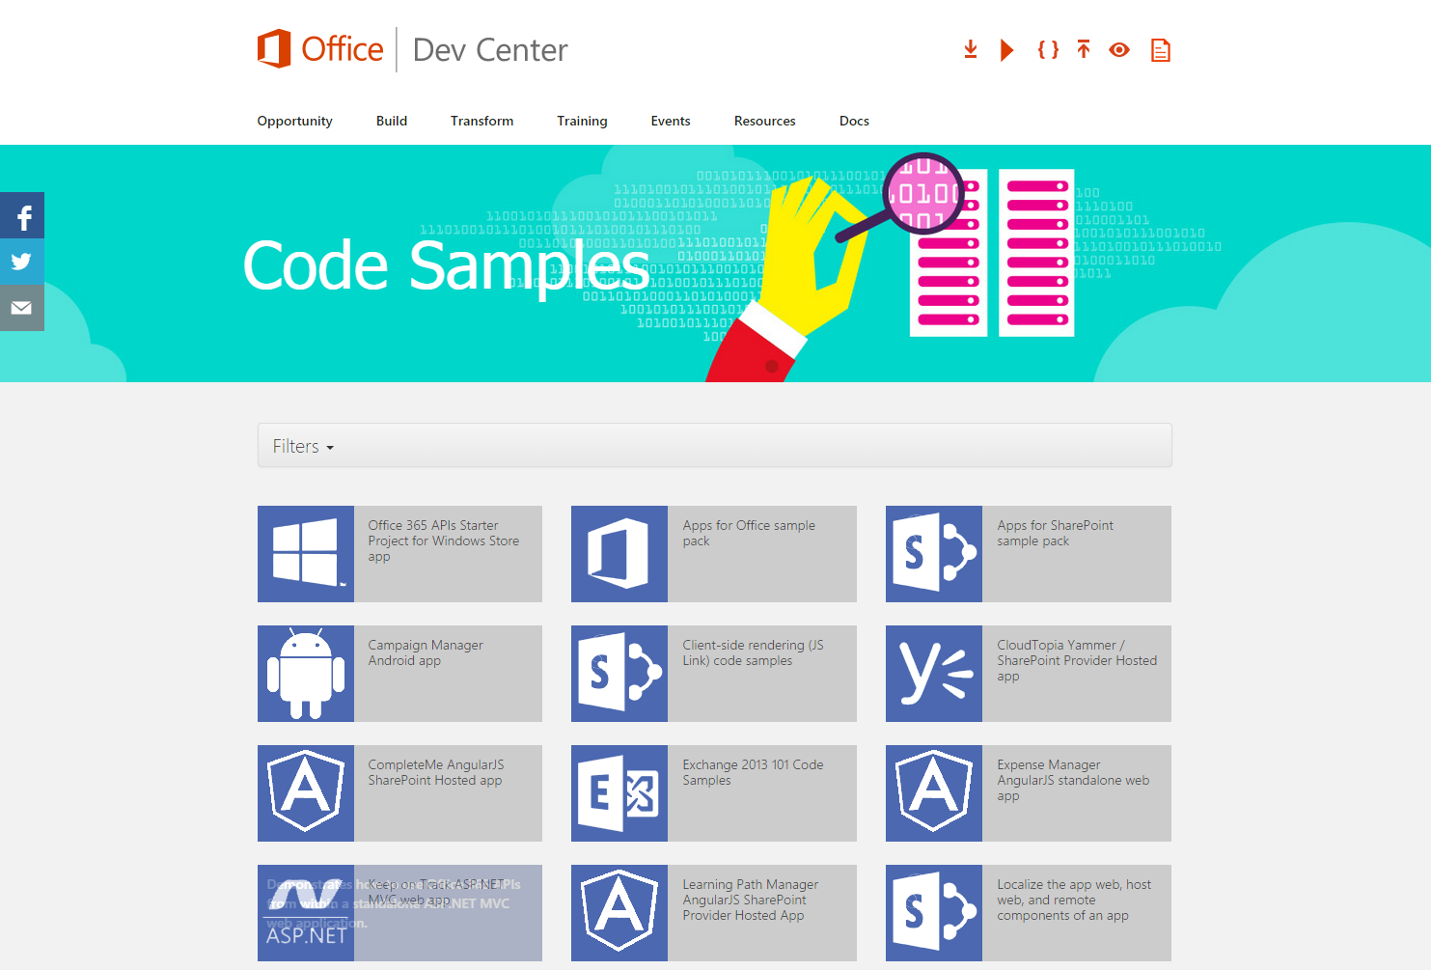
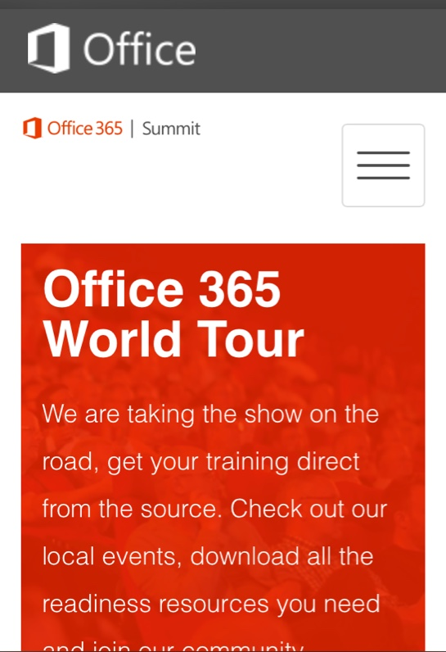
dev.office.com
Sign up
http://dev.office.com/getting-started
Explore
http://apisandbox.msdn.microsoft.com
Get trained http://dev.office.com/training

Slide 37


Feedback
Office 365 Network Share you best practices and join conversations https://www.yammer.com/itpronetwork
Stackoverflow Ask deep technical questions to a world-wide set of developers
http://stackoverflow.com/questions/tagged/ms-office
UserVoice Provide suggestions of what you want in future versions
http://officespdev.uservoice.com/

